Slide 1
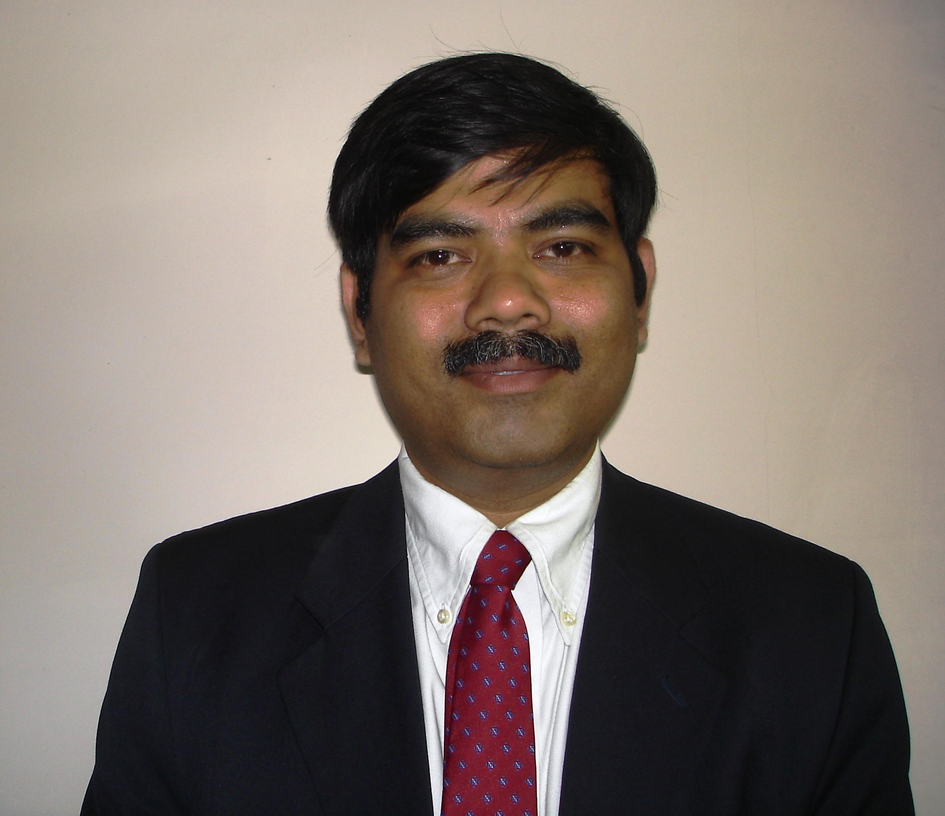
Prateep Misra
Prateep Misra is Head of Technology & Engineering and Chief Architect of the TCS IoT Platform – TCS Connected Universe Platform (TCUP). He has over 29 years’ experience in software engineering, research and technology consulting. As a thought leader in TCS' R&D organization, Prateep has been responsible for setting up Center-of-Excellence (CoEs) in the areas such as Stream Processing, Storage Systems, RFID and Digital Signal Processing. His areas of expertise include Embedded Systems, RFID, IT Infrastructure, Real-Time Analytics and Cloud Computing. He holds a B. Tech and M.Tech in Electrical Engineering, both from Indian Institute of Technology, Kharagpur. He attended Executive Leadership program conducted by Michigan Ross School of Business.
Prateep was awarded the TCS Research Distinguished Engineer Award in 2018. He has authored over 10 international patent grants and over 20 international publications.

